Slide 1

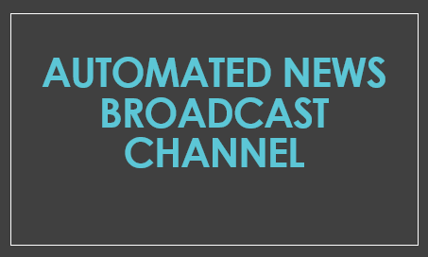

Slide 2
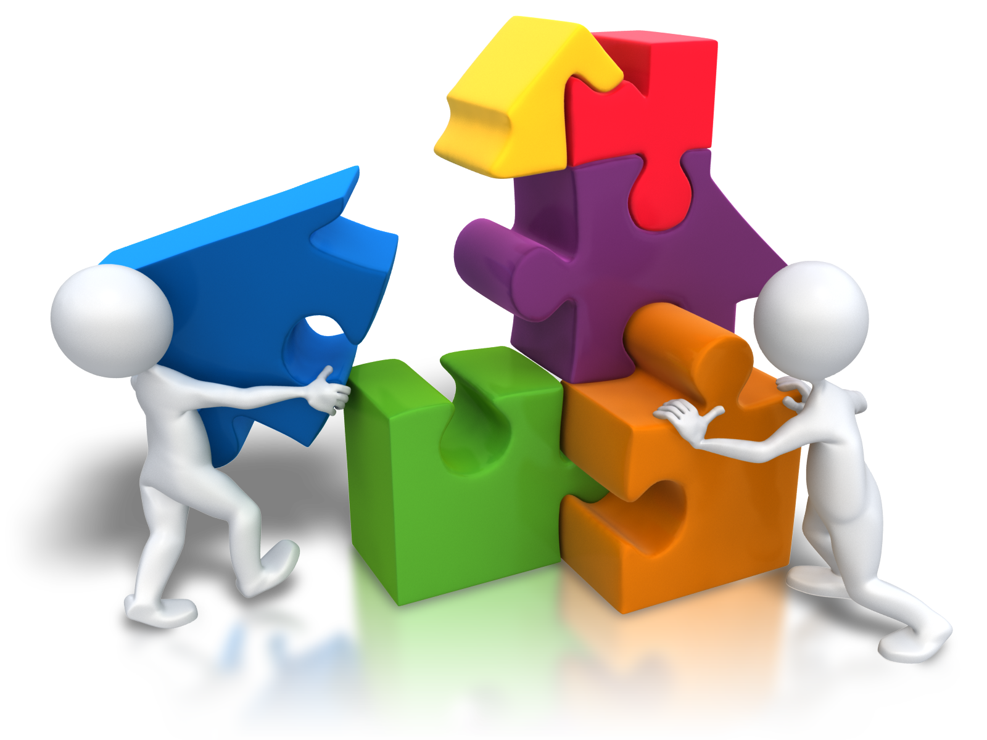
GROUP MEMBERS
FYP – CS04 (Section A)
Yusra Masood (18B-093-CS)
Rushan Rafiq (18B-087-CS)
Yumna Asim (18B-047-CS)
Shiza Khan (18B-130-CS)

Slide 3
Main Idea
The idea behind this project is to automate the process of news reporting channel by creating a web app which would aggregate the news from different news reporting websites (by scrapping data from it), filter & summarize that data and then present it.

Slide 4
working
Working of the system is as follows:
There is an admin portal from where the admin would be able to edit the URLs (i.e., add new URLs, delete any previous unwanted URLs, enable or disable any URL etc.) or read the synthesized documents (news) and disable them if needed.
From the given URL’s website, web scrapping technique is applied to gather the required data related to news content. This technique is applied after every set time interval period to refresh the new content.
Once the data is scrapped it is filtered, summarized, and news is generated out of it.
The generated news is then converted from written to oral form using text to speech library and presented to the user on the customer view page

Slide 5
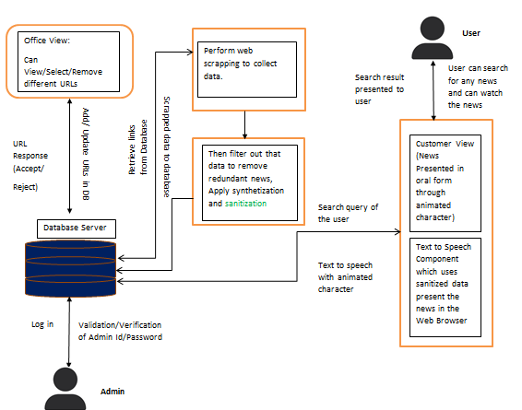
System Diagram

Slide 6
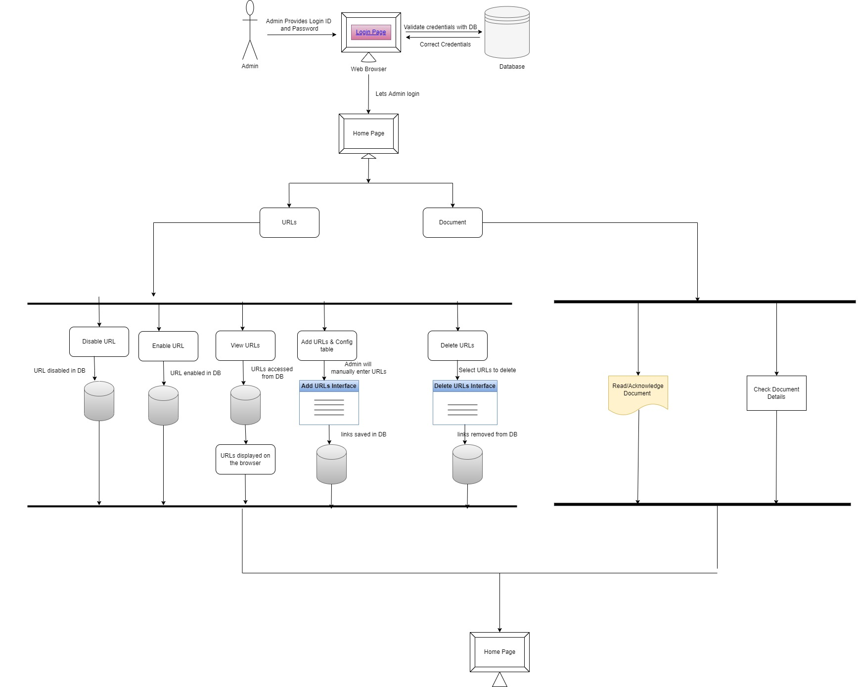
1: The admin portal

Slide 7
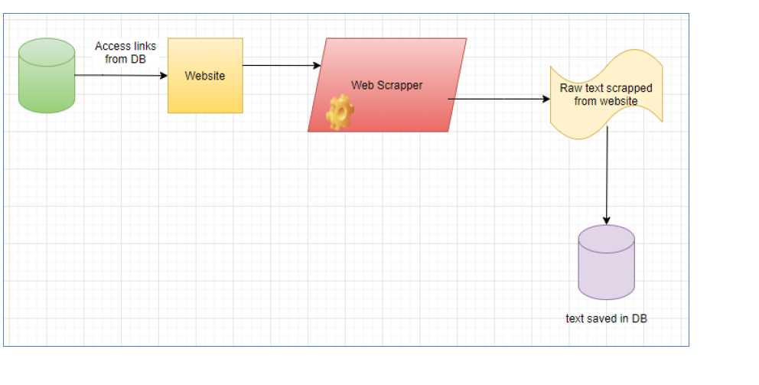
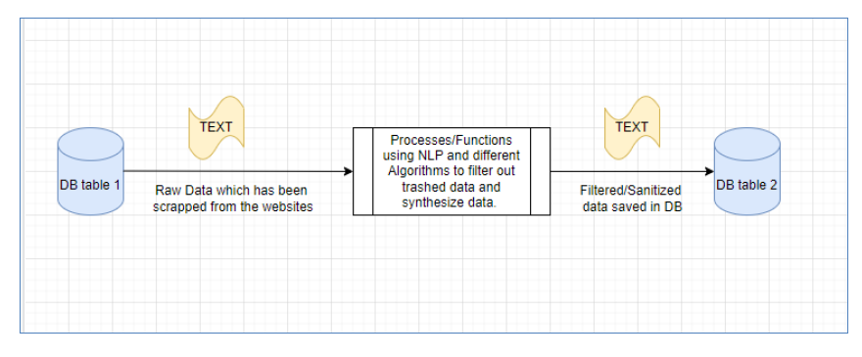

2: Web Scrapper
3: Sanitization of Data
4: Text to Speech Conversion

Slide 8
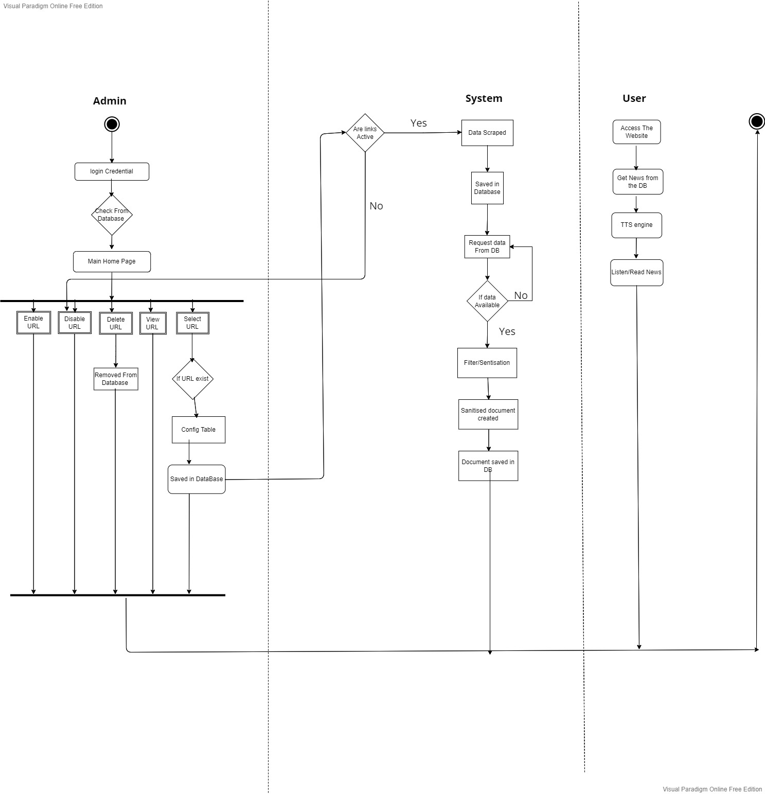
Activity Diagram

Slide 9
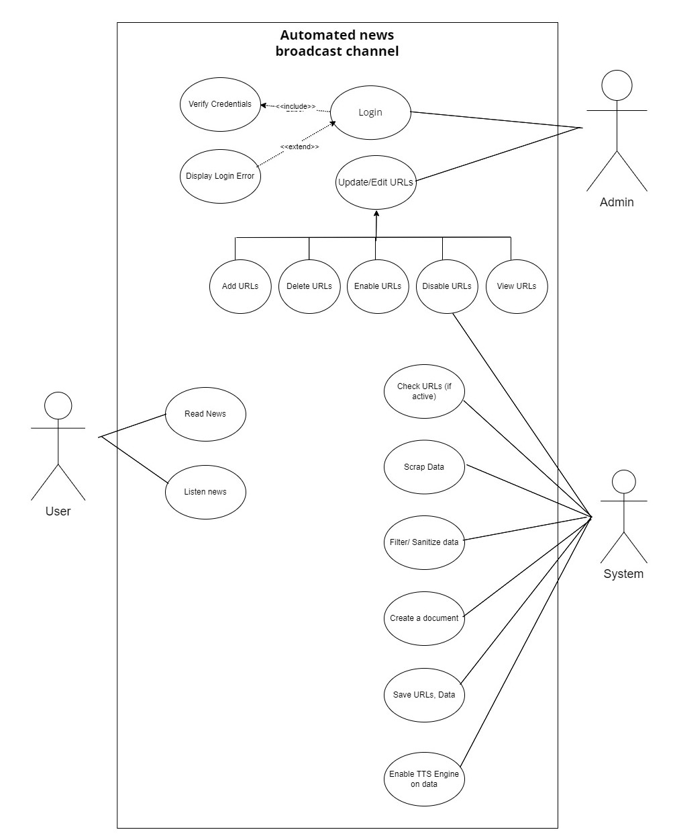
Use Case Diagram

Slide 10
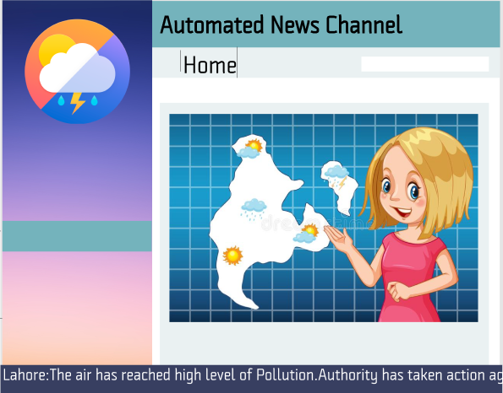
Prototype
As a User

Slide 11
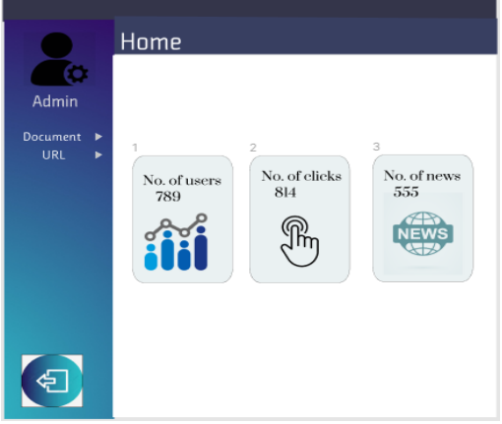
Prototype
Admin Home Page

Slide 12
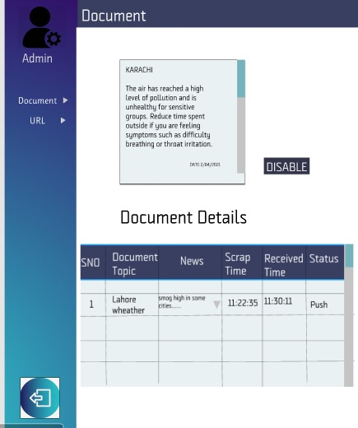
Prototype
Document Details

Slide 13
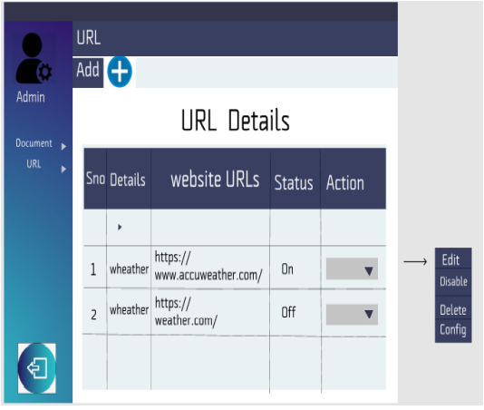
Prototype
URL details Table

Slide 14
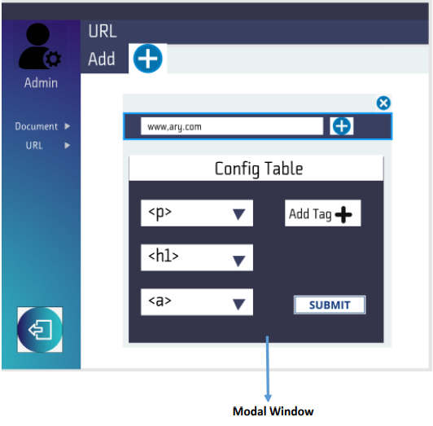
Prototype
Configuration Table

Slide 15
Stakeholders
The primary stakeholders of this project include the following:
The Development Team
The secondary stakeholder of this project includes:
News Viewer
Admin

Slide 16


